Slide 1

BS6206 Experiential Data Science Group 2​ Final Presentation
Master of Science in Biomedical Data Science
Group members:
Vu Kun Seng , Qian Hongye, Li Donghao, Zhao Zeyu

Slide 2






Content
1. Background and Goals
2. The Executive Summary
3. User profiles introduction
4. User profiles’ bussiness strategies
5. Retention strategy
6. Conclusions

Slide 3

QLab Tea: An Emerging Player in a Growing Asia Market
Origin: Est. 2020, Singapore.
Product: Premium Tea (Global Sourcing).
Channel: Online and Offline
Current Reach: SG (Core), MY & HK (Emerging).
KEY CHALLENGE:
Despite favorable market trends, QLab tea faces market size limitations and profitability concerns in its current setup.
OUR GOALS:
Understand what are different groups among current customer base
Finding the key factors influencing these groups
Develop strategies to increase revenue

Slide 4
Executive Summary:
Data-Driven Precision Marketing Yields Revenue Growth
Track 1:
Upselling (Revenue Growth)
Track 2:
Efficiency Optimization (Cost ROI)
Methodology:
Input: RFM Model + User Behavioral Features
Process: Clustering analysis to identify 3 Distinct Profiles
Strategy:Designed AOV enhancement strategies for each user profile
Methodology:
Tool: XGBoost Predictive Modeling
Logic: Calculating individual Retention Probability and Marketing Expenditure for each user​
Finding: Low retention rate user cost more
Strategy:"Abandon low retention users" Terminating spend on Negative-ROI users
Key Result:
AOV uplift strategy：
Revenue: $199,555 → $217,945
（+9.2% Jump）
Key Result:
Selective Marketing strategy：
Revenue: -$1,361 → $2,061
Core Insight: By shifting from "Mass Marketing" to "Precision Investment", we maximize the yield of every marketing dollar spent while simultaneously driving higher revenue from more valuable users.

Slide 5
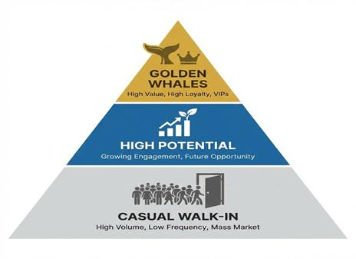
Identifying 3 Distinct User Profiles via RFM & K-Means Clustering
Full User Base → Z-score Normalization → RFM Framework → K-Means Clustering
Profile 1: Golden Whales | Profile 2: High Potential | Profile 3: Casual Walk-ins
"The Core Asset" | "The Growth Engine" | "Low-Loyalty Traffic"
Traits:• Highest AOV & Frequency • Strong brand loyalty • High contribution users | Traits:• High brand affinity • Above-average spenders • Many newer users | Traits:• Promo-driven behavior • Lower AOV & Loyalty • Attracted by ads
Business Logic:These are the brand's most valuable assets who demand premium experience. | Business Logic:The best candidates to be converted into future "Golden Whales." | Business Logic: Short term customers and low brand loyalty
Priority: Critical Retention | Priority: Value Acceleration | Priority: Cost Efficiency
Next Step:
Applying SHAP-driven insights to design targeted strategies for each group.

Slide 6
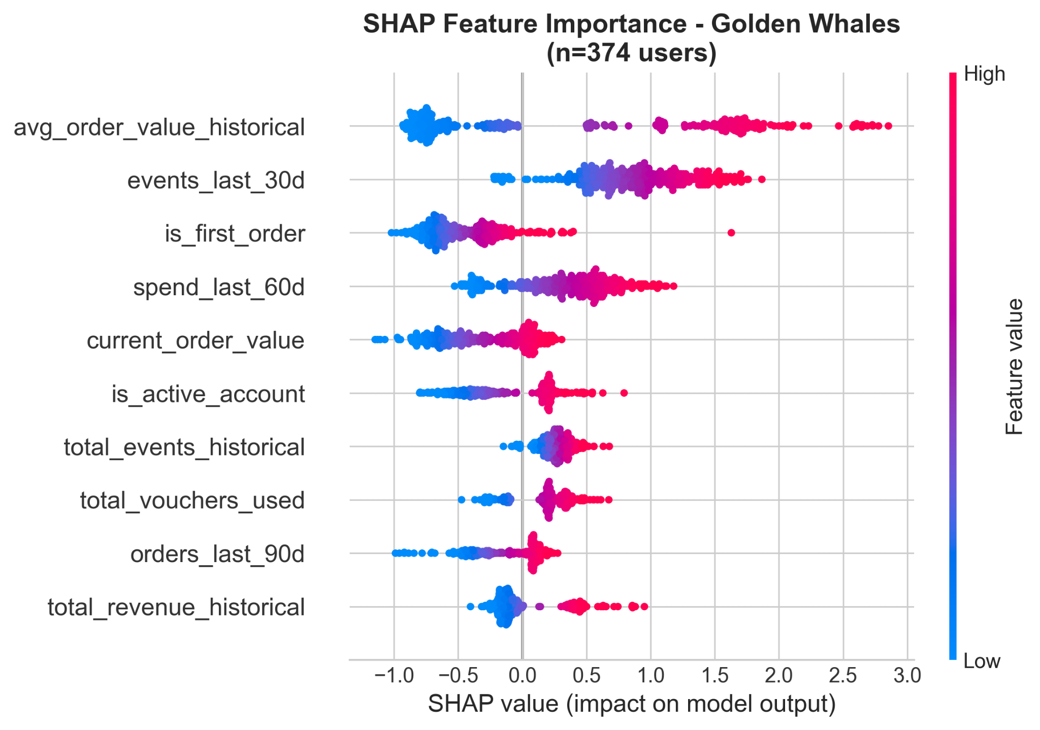
Maximizing Value for loyal customers Golden whales
📌 Golden Whales Strategy
Most valuable users: high frequency + strong AOV
Goal: Nudge incremental spend
📊 Data Insight
1. signal: historical AOV
2. signal: recent activity (events_last_30d) → hot engagement window
small, targeted incentives
🎯 Action: Threshold Nudge
Threshold ≈ 10% above avg order
Example: “Spend 20 SGD more, get 10 SGD off”
Reachable → encourages one more item
💰 Impact
+SGD 8077 incremental revenue
On top of high baseline

Slide 7
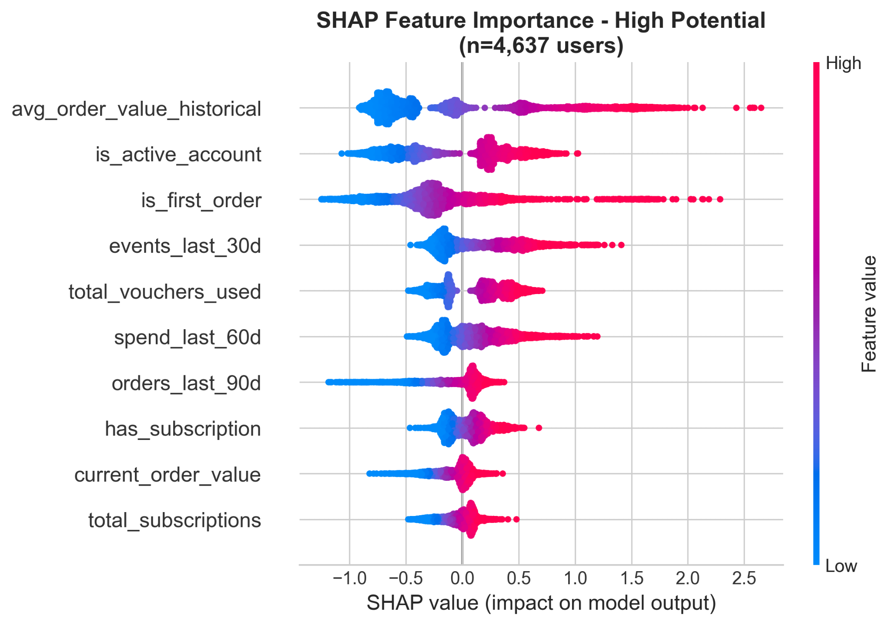
Converting Potential into Loyalty
High potential
📌 High Potential Strategy
Future growth users: clear preference, no strong purchase habit
Goal: build loyalty, see them as the future of our brand
📊 Data Insight
1. signal: is_first_order → strong positive impact→ many are high-quality new customers
First orders are the best moment to encourage customers to buy more and cultivate their brand loyalty
🎯 Action: Buy More, Save More
Encourage stock-up in early orders
Example: 1 item = $12 → 2 items = $20 → 3 items = $24
Let users feel declining marginal cost
💰 Impact
+SGD 12,322 incremental revenue
AOV uplift in first orders
Habit-building for repeat purchase

Slide 8
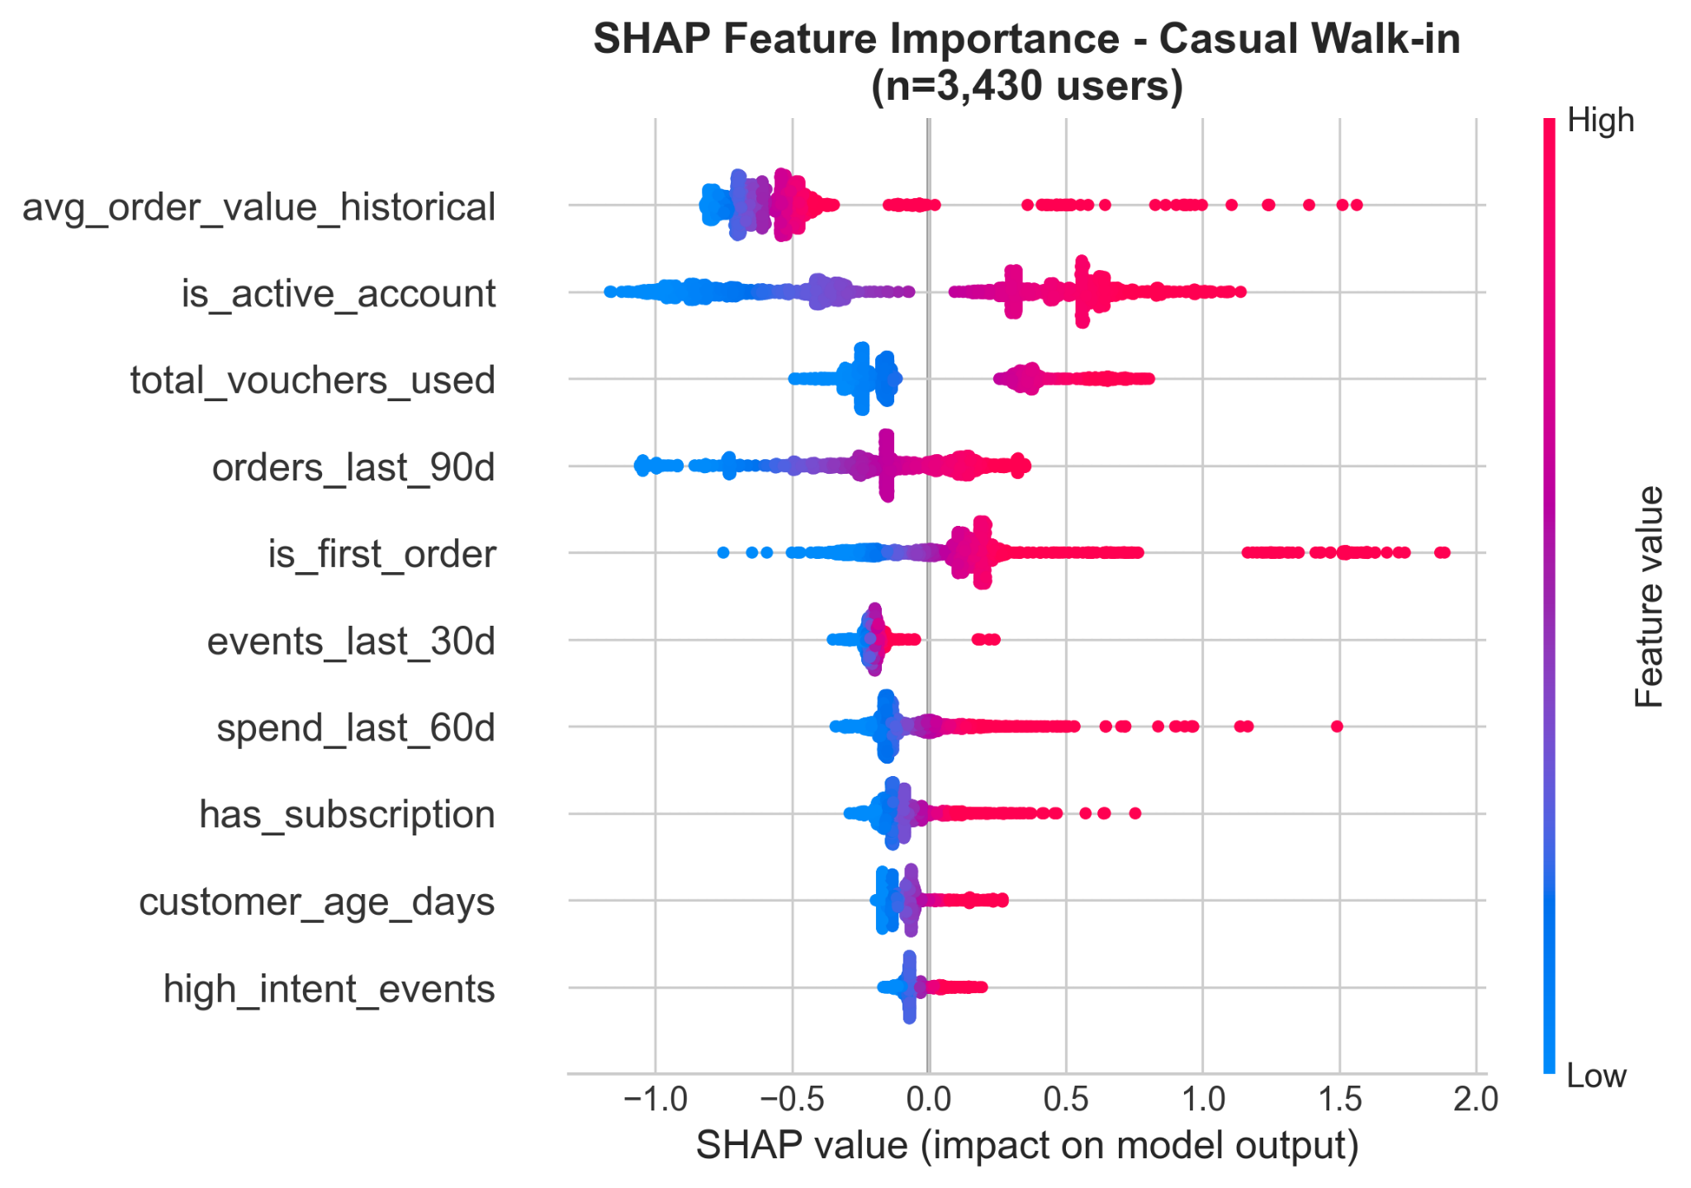
Monetizing Price-Sensitive Traffic
Casual walk in
📌 Casual Walk-ins Strategy
Low loyalty + high price sensitivity
Promotion-driven, short-term traffic
Goal: extract value without heavy investment
📊 Data Insight
Important signal: total_vouchers_used
Users come for campaigns or short term need → buy → leave
they are likely to buy just one time
🎯 Action: Add-On Limited offer at payment stage
Last-minute upsell at checkout
Low-price, high-relevance items
Examples:
“Add SGD 1.9 for 2 sample tea bags”
“Add SGD 3 for portable tea filter”
💰 Impact
+SGD 7,991 incremental revenue

Slide 9
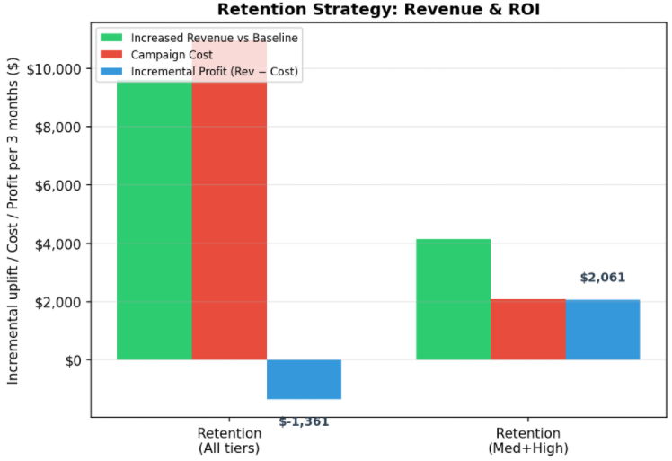
Retention Strategy: The "Addition by Subtraction" Logic
The Leak: Marketing spend on Low-retention users leads to Negative ROI.
The Tool: XGBoost Model to predict the retention "Tipping Point" for each user.
The Pivot: Terminate investment in non-responsive segments to protect margins.
Standard Marketing | "Abandon low retention users"
Focus: Reach & Volume | Focus: Quality & ROI
Net revenue: $ -1,361 | Net revenue: $2,061
Precision > Scale.
By filtering out negative-ROI users, we didn't just save budget—we optimized the entire revenue.

Slide 10
Conclusion: From "Volume-Driven" to "Value-Driven" Growth
Pillar 1: Deep Insight
Action: 3 Distinct Profiles via RFM & SHAP.
Takeaway: We stopped treating all users the same
Pillar 2: Revenue Uplift
Action: Tailored AOV Strategies (Threshold / Bundle / Add-on).
Takeaway: Maximized wallet share for every segment.
Pillar 3: Smart Efficiency
Action: "Abandon low retention users" (Smart Retention).
Takeaway: We turned net loss into net revenue.

Slide 11

THANK YOU！

Slide 12
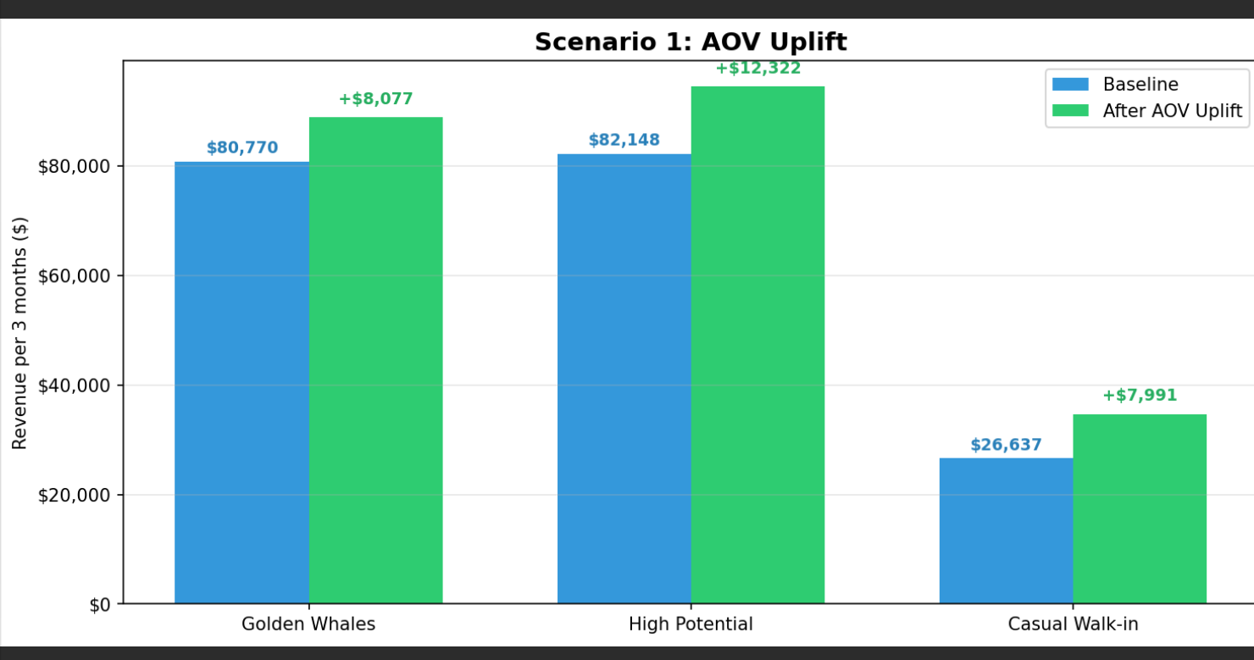
Appendix AOV Strategy Variable Setting：
AOV uplift strategy:
 | Golden Whales | High potential | Casual walk-ins
revenue uplift | 10% | 15% | 30%

Slide 13
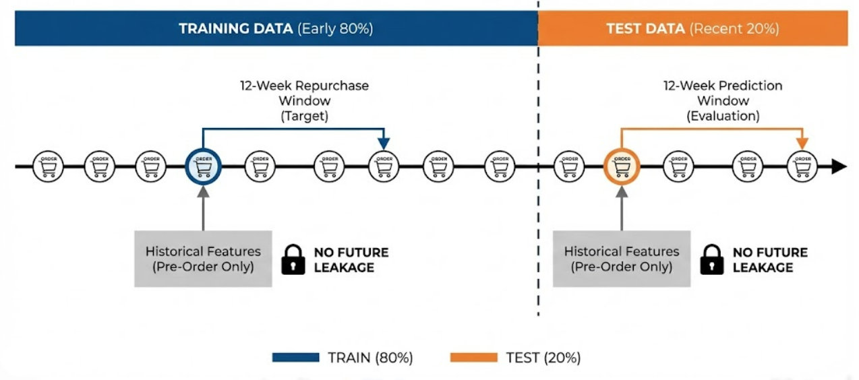
Appendix How We Calculate User Retention Rate：

